Slide 1
Laplace Noise and Multiple Additive Regression Trees
CS534 – Group 14:
Peter Rindal
Trung Viet Vu
Hung Viet Le

Slide 2
Boosting
A popular ensemble method (along with averaging methods like bagging, RF, …)
Iteratively improve the current model by emphasizing the training instances that previous models mis-classified.
Boosting Tree
Additive model and forward stage-wise algorithm
Linear combination of base predictor
Loss function – L2
Gradient boosting tree
Differential loss function
Two-step procedure: least squares + single parameter optimization

Slide 3
Multiple Additive Regression Trees (MART)
Boosting tree for regression
☺ Incrementally building an ensemble of weak predictive models with high accuracy
☹ Over-specialization: trees added at later iterations make negligible contribution

Slide 4
Laplace Noise and Multiple Additive Regression Trees (LART)
Inject randomness:
add some noises with Laplace distribution to the loss function
(Peter) – add motivation for the use of Laplace distribution
Motivation: A hybrid view between MART and Random Forest
A lot of noises means Random Forest; small noises means MART
Increase variance in the learners → robust to outliers
Based on boosting tree → high accuracy
Tuning the parameter
How to scale the Laplace noise to achieve good performance

Slide 5
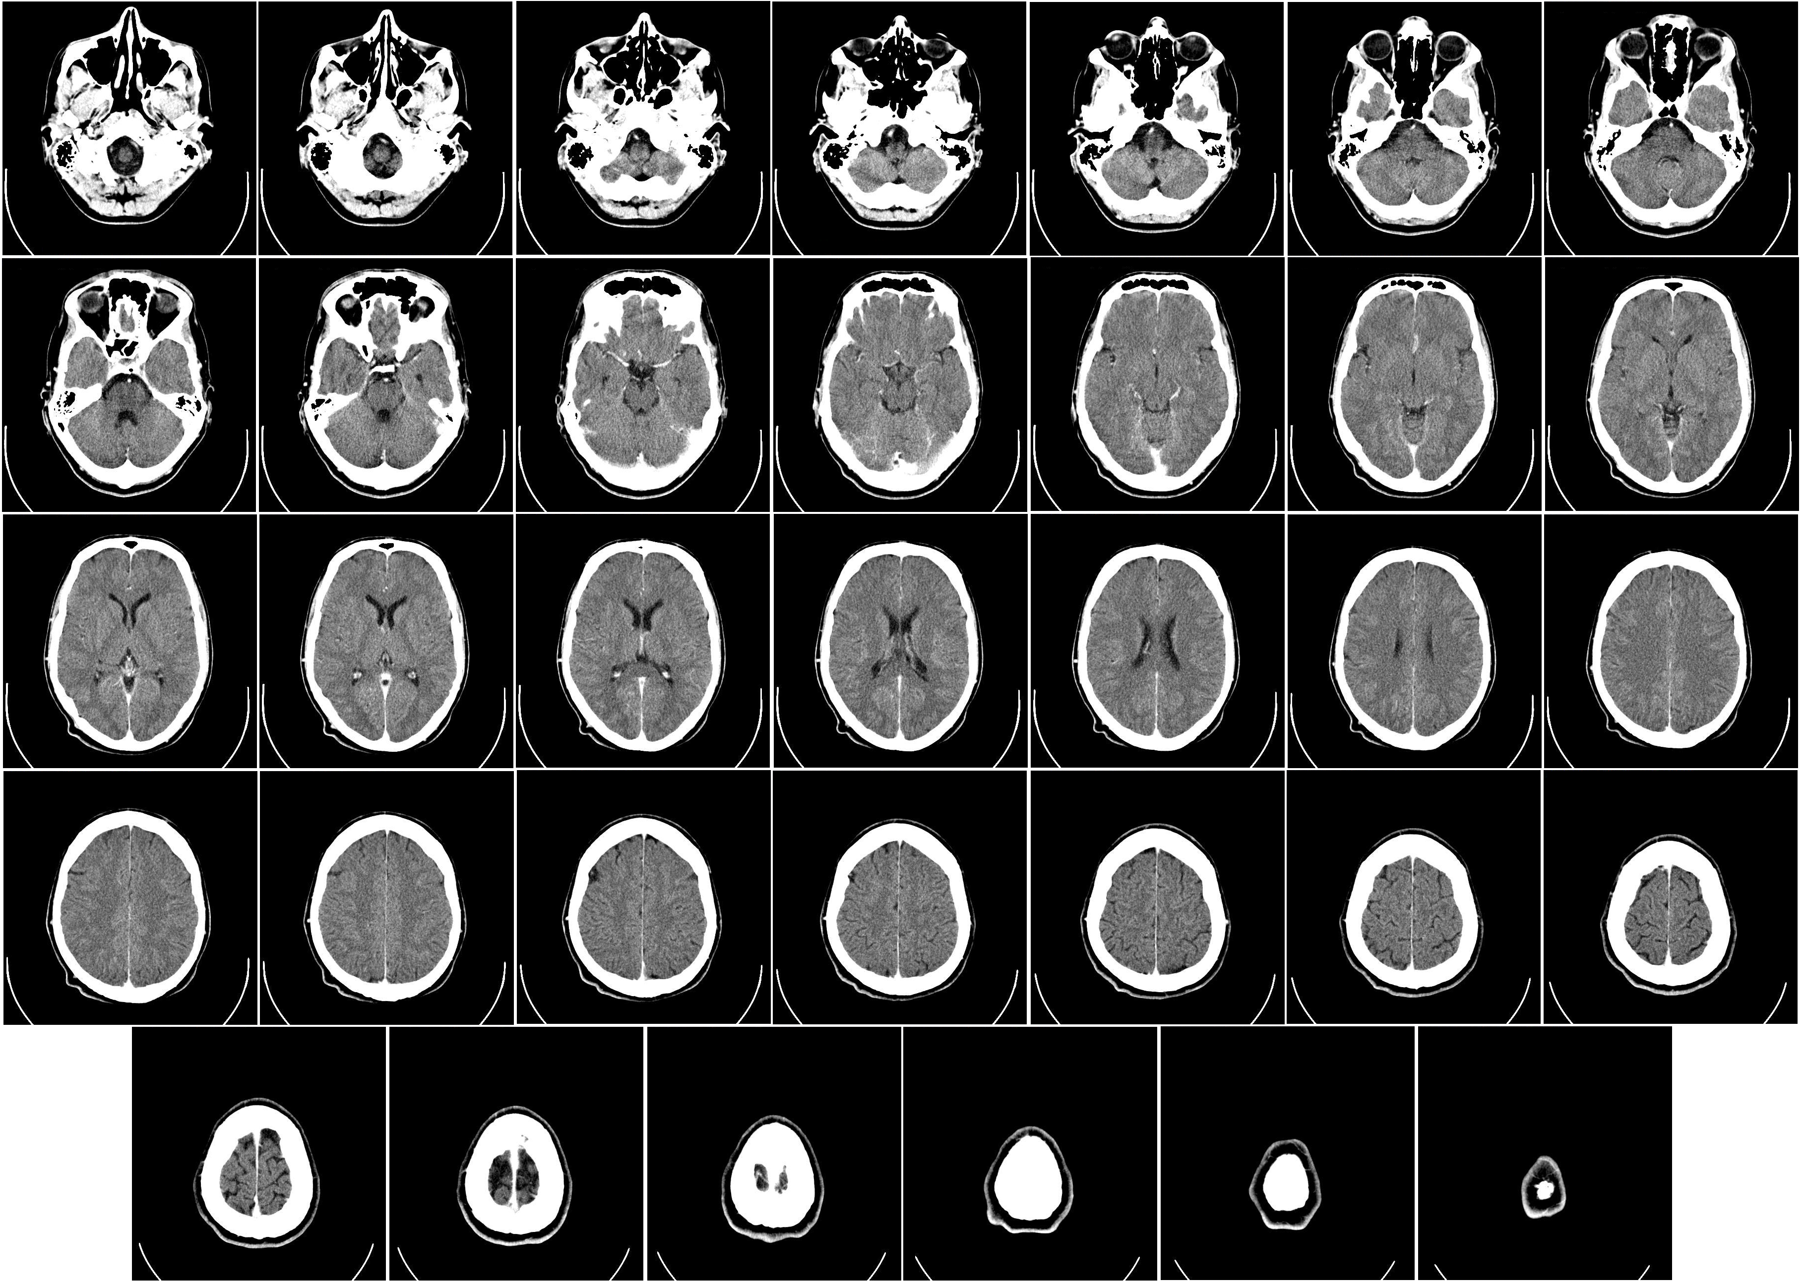
Experiments
Dataset
CT slides dataset available at the UCI repository
53500 CT images from 74 individuals
Each has 384 histogram features and 1 output value in [0;180]
Goal: infer the location of the image on the axial axis
Evaluate
Use 10-fold cross validation
Parameters:
Laplace noises’ scale, tree height, base learner number, shrinkage factor,
(Peter adds results here)

Slide 6
Conclusions
LART:
Injecting randomness as a way to overcome over-specialization
Predicates that reduce loss more are exponentially more likely to be selected.
Thank you!

